Slide 1
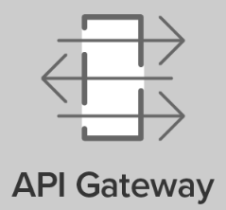
Control Tower Service
Control Tower API
/api/ct/policies
/api/ct/actions
API Client
RAG API
/api/rag/policies
/api/rag/actions
RAG Service

